Slide 1
Block Cipher Modes of Operation
What is the need?
How do they work?

Slide 2
What’s the problem?
Block Ciphers take b bits of plaintext to make one block.
If the plaintext has a length more than b bits, then we will create more blocks
Applying same key on all the blocks has a potential security risk
Block Cipher Modes will enhance the applicability of encryption algorithms in a wide range of applications

Slide 3
plaintext (256 bit)
block size 64 bit
block size 64 bit
block size 64 bit
block size 64 bit
Key K

Slide 4
Block Cipher Modes of Operation
Electronic Code Book (ECB)
Cipher Block Chaining (CBC)
Cipher Feedback Mode (CFM)
Output Feedback Mode (OFM)
Counter Mode (CTM)

Slide 5
Electronic Code Book
Each possible block of plaintext will have a unique ciphertext block
Divide the plaintext into blocks and pad the last block if necessary
The code book contains the pairs of all possible plaintext blocks and their corresponding ciphertext blocks
It is the most simplest method and can be applied where single values need to be securely transmitted
Not suitable for lengthy messages

Slide 6
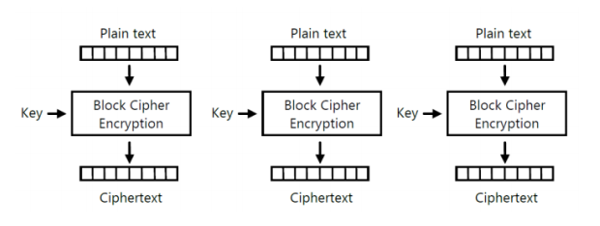

Slide 7
Parameters to consider for further studies
Overhead
Error Recovery
Error Propagation
Diffusion
Security

Slide 8
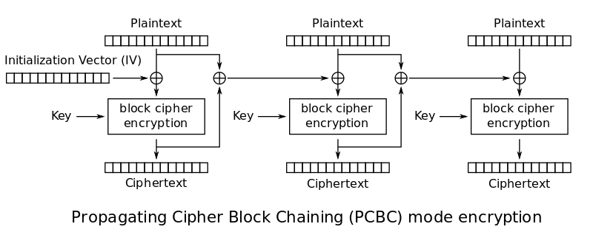
Cipher Block Chaining

Slide 9
Same key is used for all the blocks
current plaintext block is XORed with preceding ciphertext block
This is chaining the plaintext blocks one with another
This makes cryptanalysis difficult
Last block may need padding
IV can be generated in two ways

Slide 10
Cipher Feedback Mode
We can covert a block cipher into stream cipher
stream cipher eliminates the need of padding
Stream ciphers are real time
In character stream ciphers, length of plaintext and ciphertext are same
Plaintext is divided into segments of s bits

Slide 11
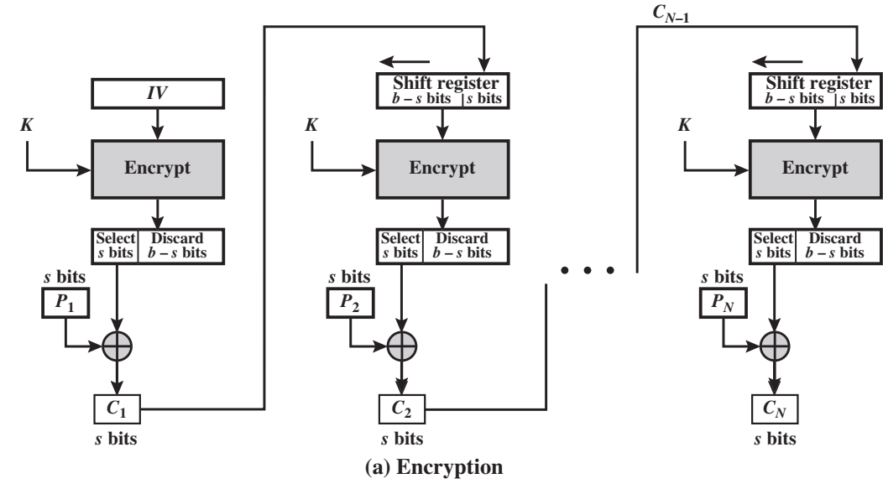
Cipher Feedback Mode

Slide 12
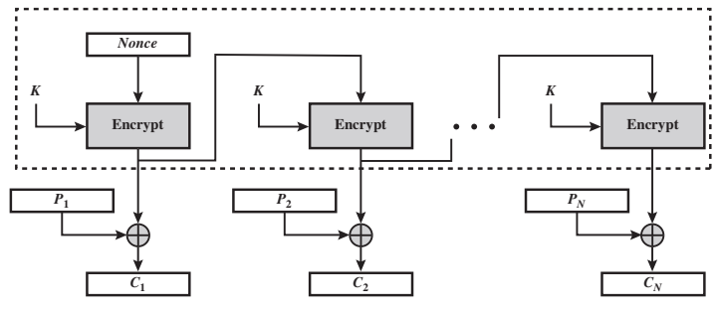
Output Feedback Mode
unique

Slide 13
Error propagation is controlled
More vulnerable to message stream modification attack
The attacker makes changes to checksums and data to alter the cipher text
Such changes cannot be detected by error correcting codes
OFB is much similar to traditional stream ciphers

Slide 14
Counter Mode
Gained popularity with the introduction of asynchronous transfer mode and IP Security
Counter has a size same as plaintext block
Counter value must change for each block
Some value is initialized then incremented by 1
No chaining
Counter value is encrypted and then XORed with plaintext block
The last plaintext block may be partial with u bits, the MSB are used in XOR and remaining b-u bits are discarded

Slide 15
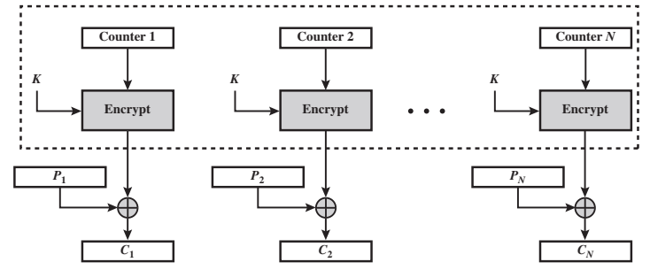
Counter Mode

